Slide 1
SQL Reporting Services and your sanity
Greg Celentano

Slide 2
Agenda
Where do we get started with SSRS
Configuration manager and configuration files
SSRS fundamentals
What to look at when analyzing performance
Scaling up / Scaling out

Slide 3
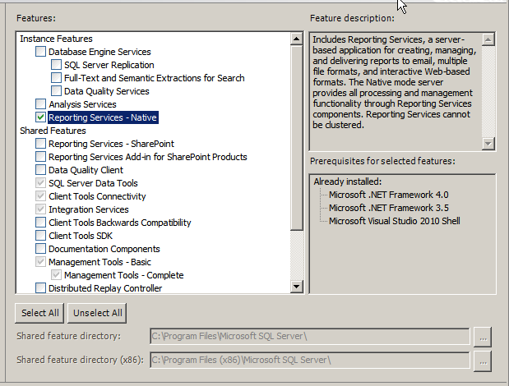
Where to start
Installation
Native & SharePoint options
This installs SSRS on the Instance you selected earlier
Multiple SSRS instances are legal

Slide 4
But wait…Before we install
Did you ask the right questions to the user
What is the application?
Who will be using this application?
What is the importance of this application?
What is the approximate size of the data?
Whatever else you feel is an important question about the application

Slide 5
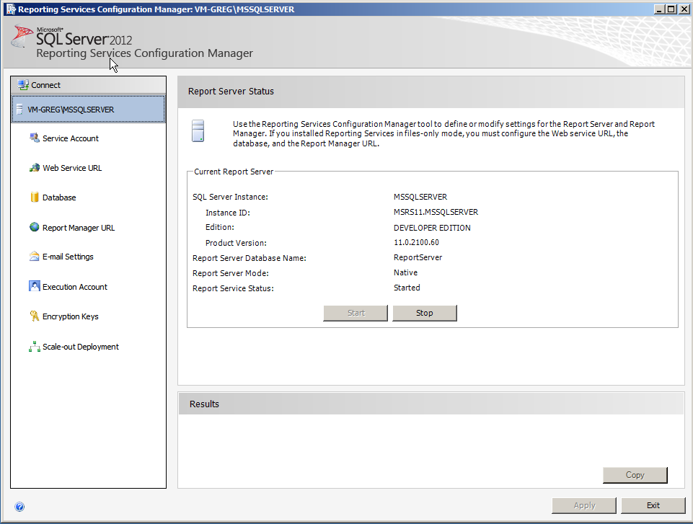
Configuration Manager Demo

Slide 6
RsReportServer.config
Create a backup first
Modify at your own risk
CREATE A BACKUP FIRST!!!!!!!!!!
MSDN Guide to RsReportServer.config
https://msdn.microsoft.com/en-us/library/ms157273.aspx

Slide 7
Reports
Pre SQL 2012 – Business Intelligence Development Studio (BIDS)
After 2012 – Data Tools

Slide 8
Data Sources
Microsoft SQL Server
Microsoft SQL Server Analysis Services
Microsoft Azure SQL Database
SQL Server Parallel Data Warehouse
Oracle
SAP NetWeaver BI
Hyperion Essbase
Microsoft SharePoint List
Teradata
OLE DB
ODBC
XML
Linked Servers*

Slide 9
How to monitor and things to look for
Executionlog2 view
Sp_who2 ‘active’
Profiler
Third party tools
Watch for CreateChunkSegment and WriteLockSessions, indicators of SSRS resource pressure
Demo

Slide 10
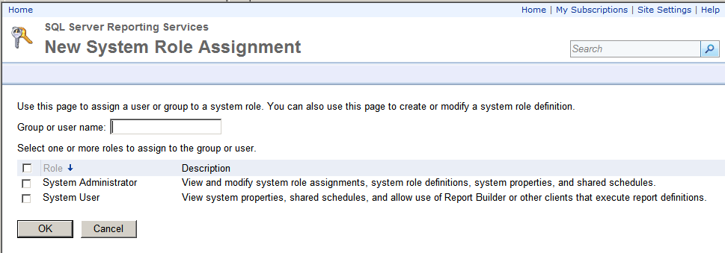
Security (Demo)

Slide 11
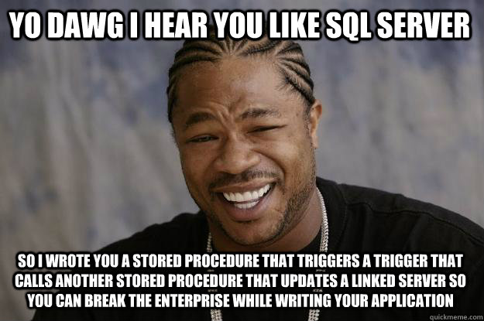
Performance Options
http://www.quickmeme.com/meme/3qix7d

Slide 12
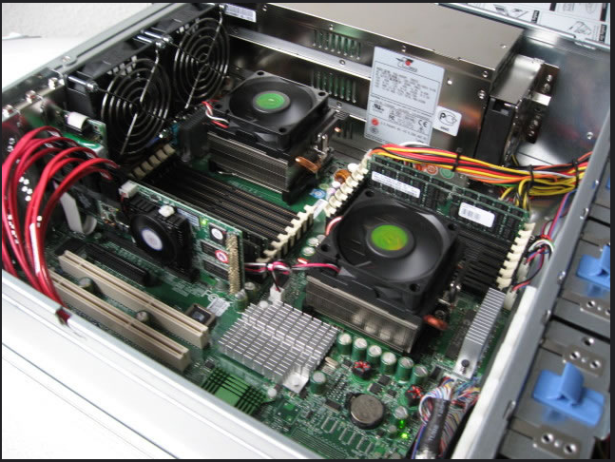
Option 1
Scale up
https://www.flickr.com/photos/91707070@N03/8329864546" title="server hardware by Sivaserver, on Flickr

Slide 13
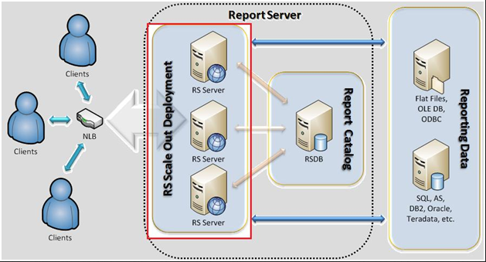
Option 2
Scale Out
http://dennyglee.com/2012/10/01/enterprise-reporting-services-jump-start-guide/

Slide 14
Scaling out SSRS
SSRS service (ReportingServicesService.exe)
SSRS databases (ReportServer & ReportServerTempDB)

Slide 15
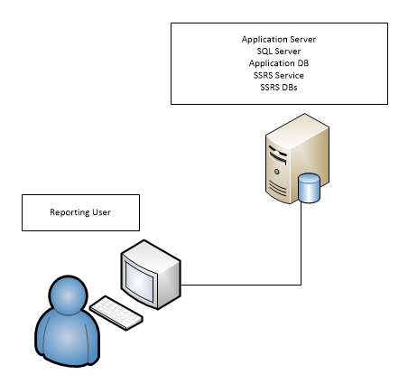
Moving the SSRS DBs

Slide 16
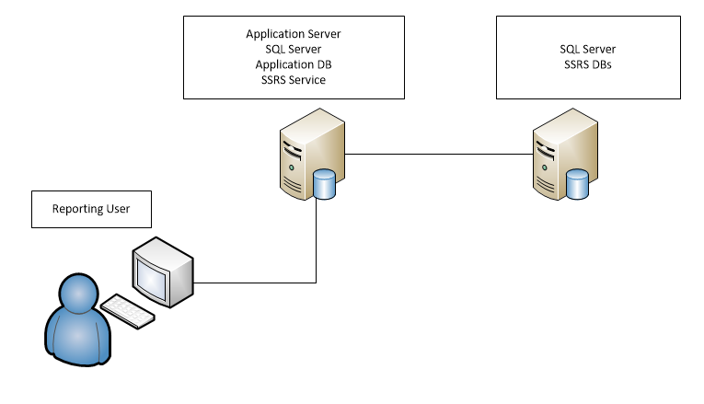
A simple example

Slide 17
Simple scale out pros & cons
Pros
Users access the same web address
Relieve pressure on the Application SQL instance
Possible future growth into reporting off a replica
Cons
Network bandwidth

Slide 18
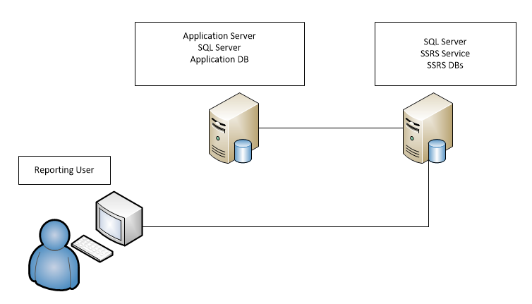
Other Scale out options

Slide 19
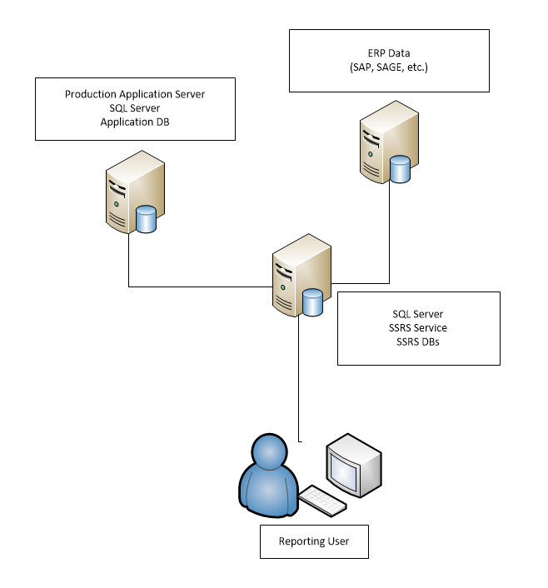

Slide 20
Complex Scale Out Pros & Cons
Pros
User can run larger datasets
Results should process faster
Cons
More complex topology
More services to monitor
Licensing cost

Slide 21
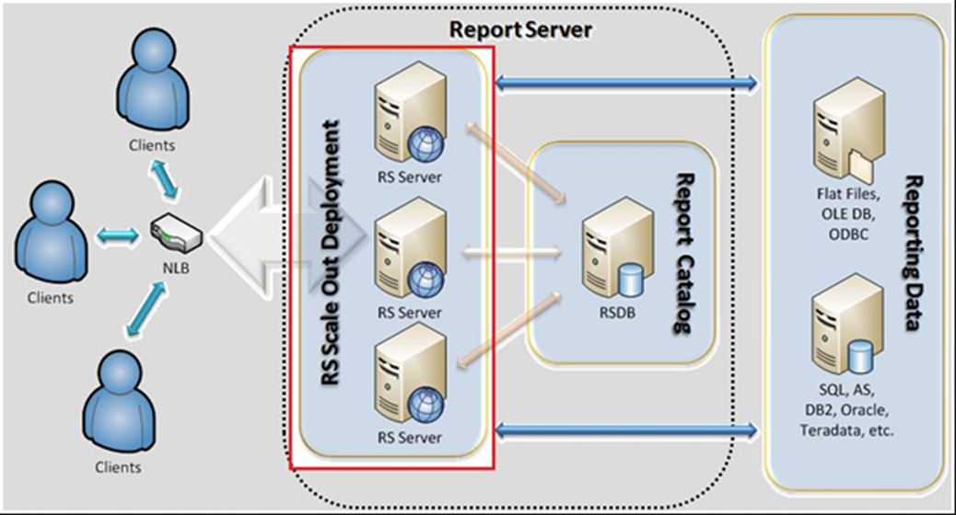
Scale Out Demo

Slide 22
Recap
We learned what goes into an install of SSRS
How reports are designed will have an impact on performance
Simple ways to find bottlenecks
Scale out options

Slide 23
Links
Technet guide on Scale-Out Deployment
https://technet.microsoft.com/en-us/library/ms159114%28v=sql.105%29.aspx

